Slide 1
AI POWERED
BRIDGE THE GAP
STUDENT WELL-BEING
BETWEEN RAW STUDENT DATA AND ISTITUTIONAL
INSIGHTS TO PROACTIVELY ADDRESS STUDENT STRESS
DASHBOARD
HACKATHON GEN-AI COHART-3 | SEP 2025

Slide 2


DATA OVERLOAD, INSIGHT SECURITY
Universities possess extensive survey data but lack the tools to rapidly diagnose specific stress factors. This leads to reactive, rather than proactive, support.
THE PROBLEM
SILENT CRISES
A DISCONNECT FROM GLOBAL GOALS
Institutional actions are often not explicitly linked to broader objectives like the UN's Sustainable Development Goals, missing an opportunity for impactful reporting and strategy.
IN EDUCATION
THE CORE ISSUE
How can we empower administrators to understand the nuanced drivers of student stress in real-time to foster a healthier and more effective learning environment?

Slide 3
OUR SOLUTION: AN INTELLIGENT INSIGHT ENGINE
An interactive dashboard that transforms complex survey data into clear, actionable intelligence.
AI GENERATED EXECUTIVE REPORTS
Instead of spreadsheets, users get narrative summaries, key findings, and concrete recommendations in seconds.
SEAMLESS & AUTOMATION VISUALIZATION
The application intelligently generates the most relevant chart to visually represent the report's main insight, creating a powerful, cohesive story.
DIRECT ALIGNMENT WITH SDGs
The Every analysis is framed through the lens of SDG 3 (Good Health & Well-being) and SDG 4 (Quality Education), turning insights directly into strategic actions.

Slide 4
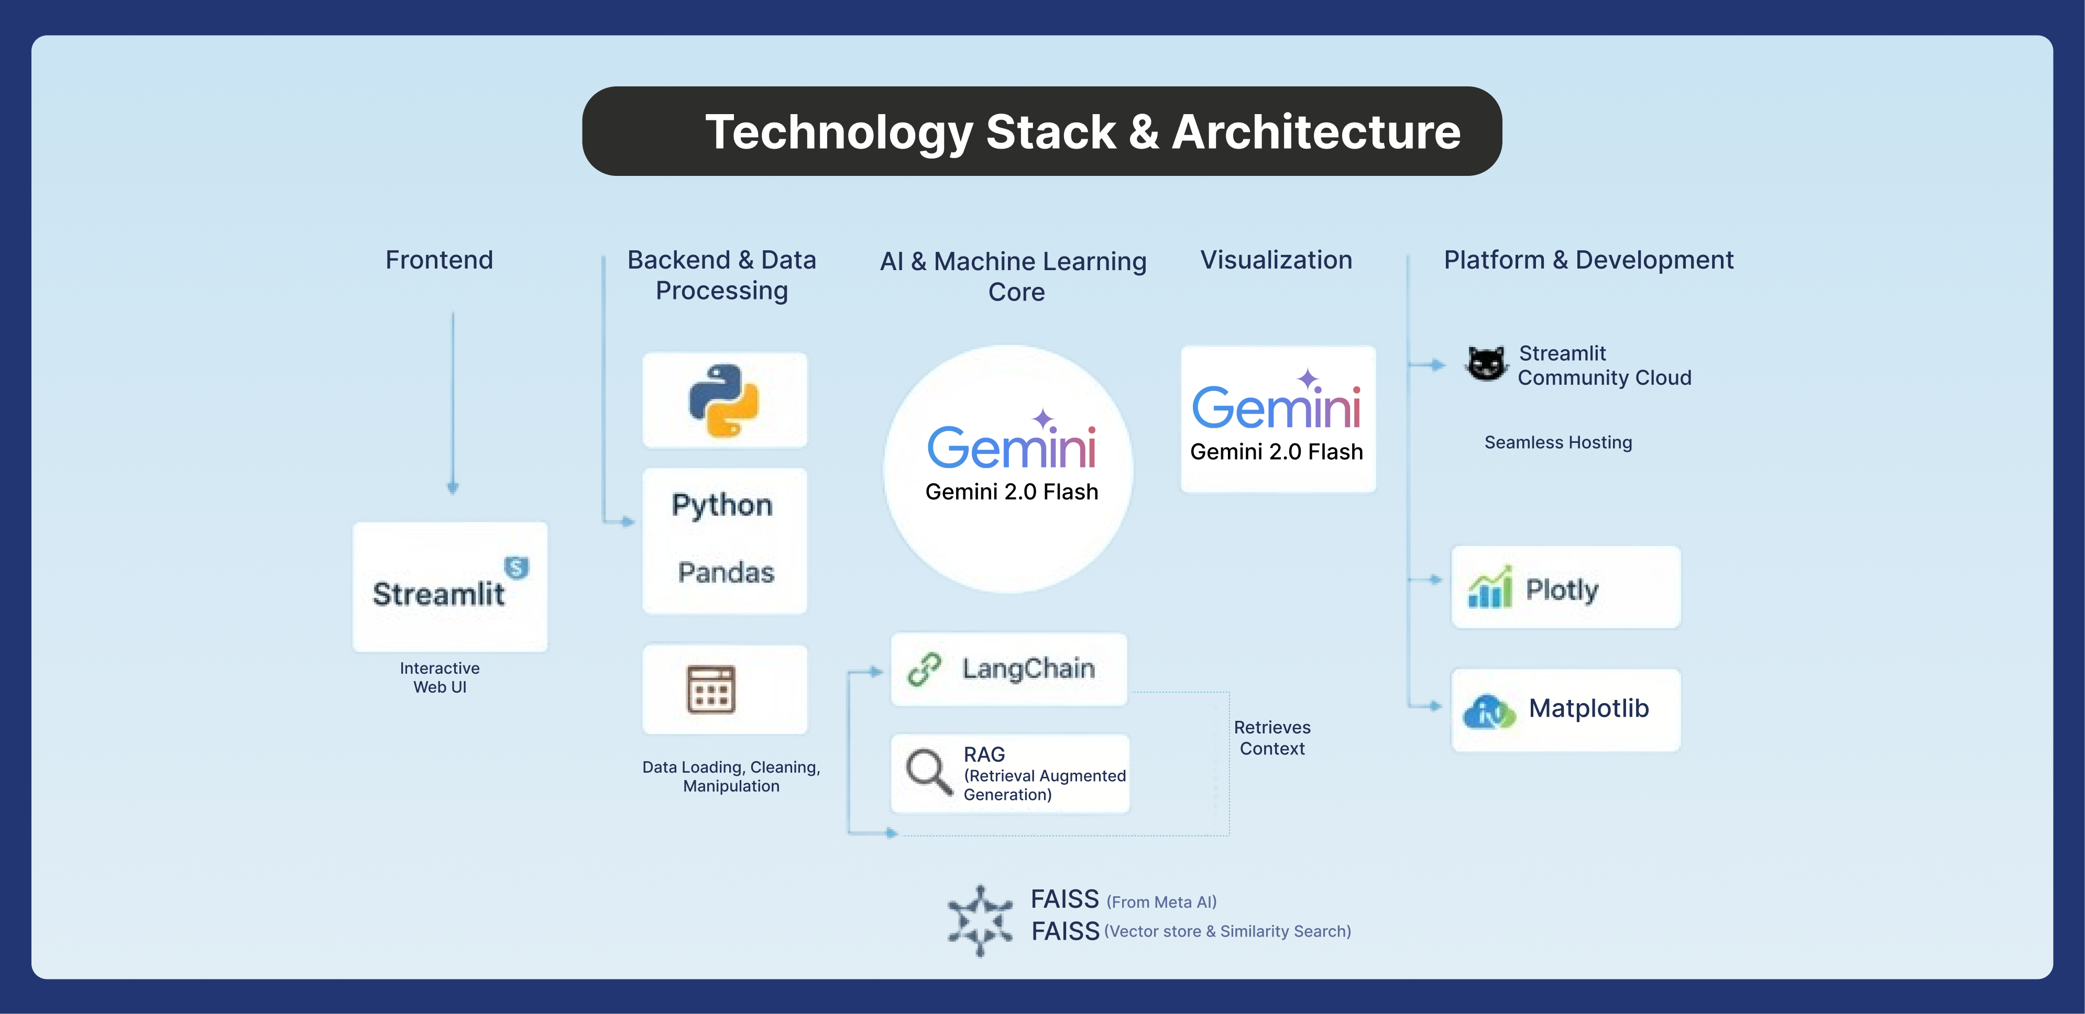

Slide 5
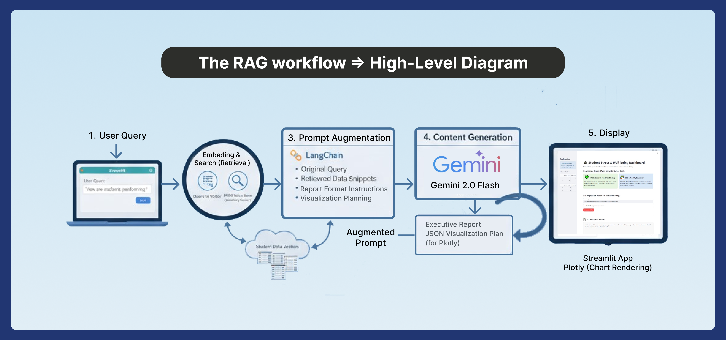

Slide 6
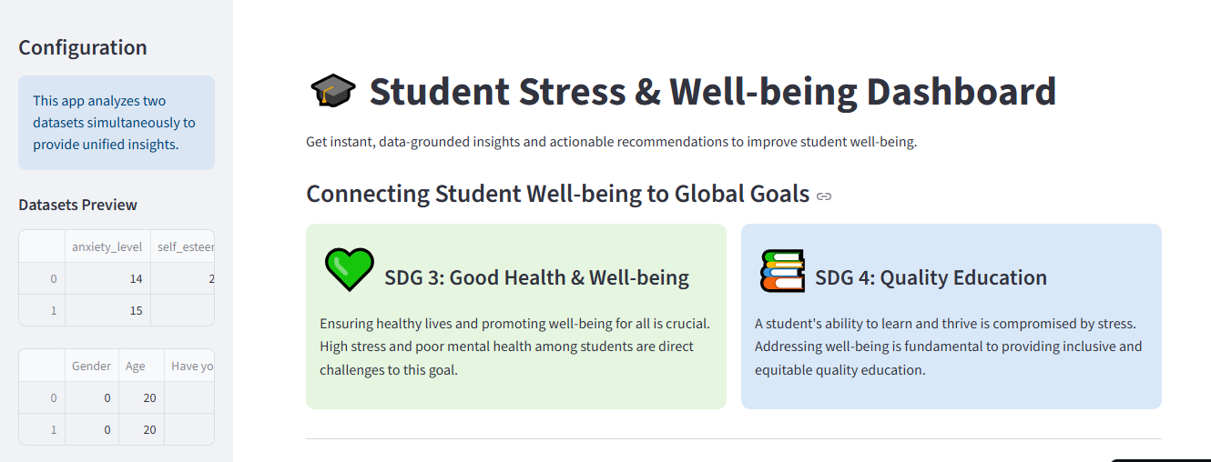
LIVE DEMO LINK
https://ai-powered-student-well-being-dashboard-etpwsgesvy7cn5aswz9xan.streamlit.app/

Slide 7
TEAM MEMBERS
ALTAF HUSSAIN – PROJECT LEAD LINKEDIN PROFILE
AHMED ISHFAQ – MEMBER
FARYAL NIMRA – MEMBER
ASHHAL KALEEM – MEMBER
HAFIZ MUHAMMAD BURHAN un NADEEM– MEMBER
ABDUL WAHAB – MEMBER

Slide 8
TOWARDS GREATER SYNEREGIES

